Slide 1
CoDeSys Overview
Environment, System operations, and Simulations

Slide 2
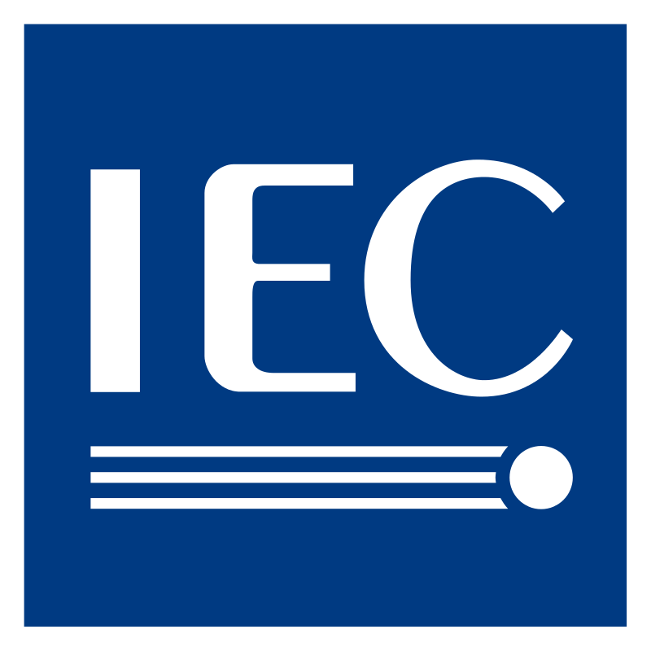
What is IEC 61131
IEC specification 61131 is a codified standard for Programable Controllers
The International Standard IEC 61131 applies to programmable controllers (PLC)
and their associated peripherals such as programming and debugging tools (PADTs),
Human-machine interfaces (HMIs), etc. which have as their intended use
the control and command of machines and industrial processes.
Started in 1982 and published in 1993 as IEC 1131
International Standard for Programmable Controllers.
10 Parts of the IEC 61131 Standard
1) General Info and Definitions, 2)Equipment Req’s and Tests, 3)Programming Languages, 4) user guidelines
5) Messaging Service 6) Functional Safety controls 7) Fuzzy Logic 8) Guidelines for Implementing Program Languages
9) Single Drop Communications Interface (SDCI) (Committee Review) 10) PLC XML standard for device programming (in review)

Slide 3
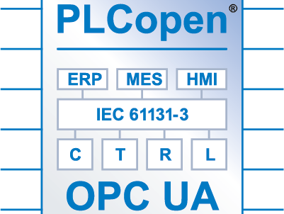
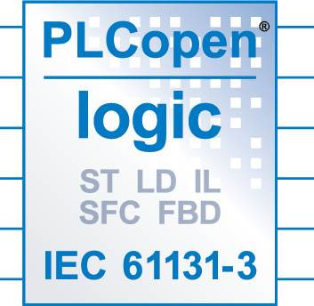
PLCopen and IEC 61131-3
PLCopen is a vendor and OEM independent organization that has driven much of what we use today for PLC Programming.
IEC 61131-3 is the first real endeavor to standardize programming languages for industrial automation. With its worldwide support, it is independent of any single company.
PLCopen recognized the opportunity to create global standard and open the market for other OEM’s
61131-3 Focuses on Object oriented programming for maximum code reusability
There are 6 specified programming languages, 2 Textual and 3 Graphical

Slide 4
Language Structures and Syntax
IEC 61131-3 specifies that the programming languages Ladder, Instruction List (IL),
Structured Text (ST), Function Block (FB), and Sequential Function chart (SFC) shall be
Utilized, and specifies methods for implementation
Common elements are specified to allow interaction between programming software suites
And for deploying the code to a controller device
Further common elements are specified for the formatting and inclusion of reusable progamming
Elements such as, Function Blocks, Functions, Libraries.
http://www.plcopen.org/pages/tc1_standards/iec61131-3/index.htm

Slide 5
IEC Programing perspectives
IEC 61131-1 Programming Methods
Top Down
Common Elements
Bottom Up
Programming Languages
Common Elements are the Functions, Function Blocks, Libraries, and elements that can be used over and over.

Slide 6
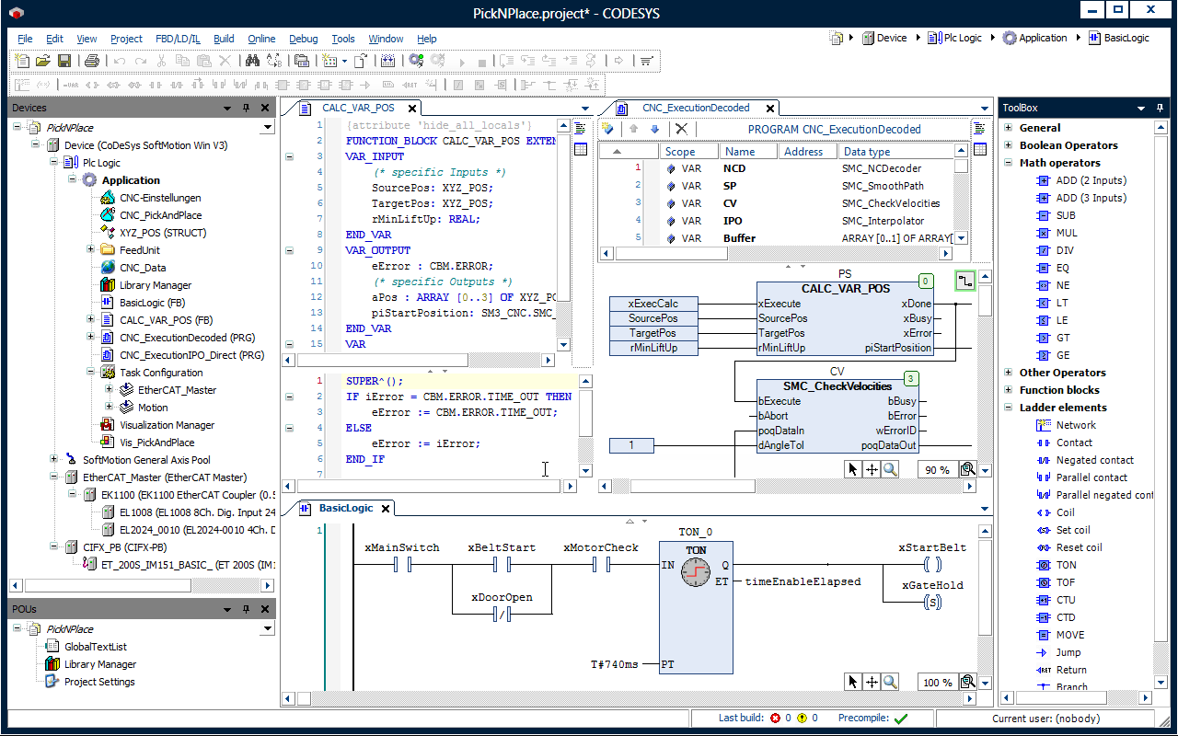
So what is Codesys?
Programming examples in different languages
Isnt Allen Bradley the PLC company? What is this cheapo free stuff?

Slide 7
Codesys 3S
IEC 61131-3 Programming language IDE.
V1.0 released in 1994.
Currently over 600 devices programmed by CODESYS
The premier vendor independent PLC programming IDE
Codesys is not just an IDE, it installs a real time PLC onto your PC. !
The IDE ALSO supports building HMI’s and instantiating web services allowing browser clients to connect
Codesys also has add on modules and supports the creation of Libraries
CODESYS will teach you to Code… So lets get started

Slide 8
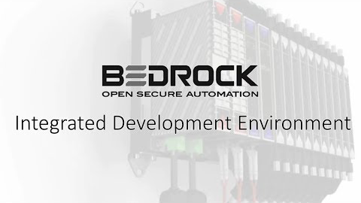
Bedrock IDE Quick Overview

Slide 9







More than just a few companies are using CODESYS as their platform

Slide 10
Questions?
OK, 1 sentence what is IEC61131-3
How does this help us to program??

Slide 11
Project #1
Lets show you that this really works… so that you can play with the IDE at home.
We have a few more lessons before we are going to program again.

